Slide 1
Namespace and cgroup
ow

Slide 2
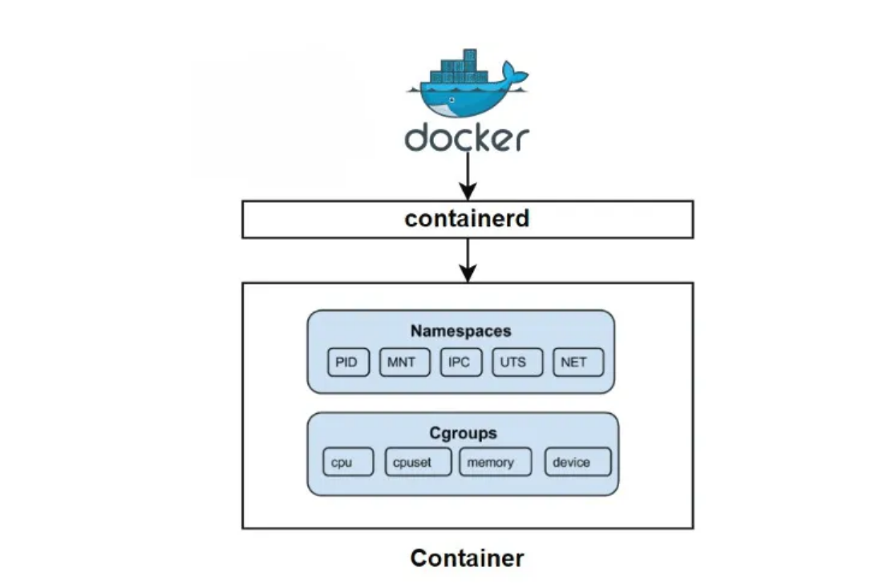
intro

Slide 3
Process sharing
In a normal computing environment, all processes share the same system resources like CPU, memory, and files. Without isolation, they can interfere with each other, causing problems like:
Resource Contention: Multiple processes competing for the same CPU or memory can slow things down.
Security Risks: One process could access or modify another process’s data, leading to vulnerabilities.
Dependency Conflicts: Different applications may need different software versions, causing compatibility issues.
This lack of separation makes managing and securing processes difficult, leading to instability and unpredictable behavior.

Slide 4
LINUX NAMESPACES
Namespaces are a feature in the Linux kernel that help isolate processes from each other. They allow different processes to have their own separate view of system resources, like:
Files(each process can have its own file system view)
Network (each process can have its own IP and network interfaces)
Processes(each process sees only its own group, not others)
This isolation is the foundation of **containers** (like Docker). Instead of using heavy virtual machines, containers use namespaces to create lightweight, isolated environments.
Solomon Hykes the founder of Docker, used these Linux features to build Docker, which transformed how applications are deployed and managed.

Slide 5
Docker ns
Docker uses namespaces to create isolated environments called containers.
When you run a container, Docker creates separate namespaces for:
- Processes – Each container runs its own processes, separate from others.
- Network – Each container has its own IP, ports, and network interfaces.
- Mount Points– Each container has its own file system view.
This ensures that containers do not interfere with each other, making them secure and independent.

Slide 6
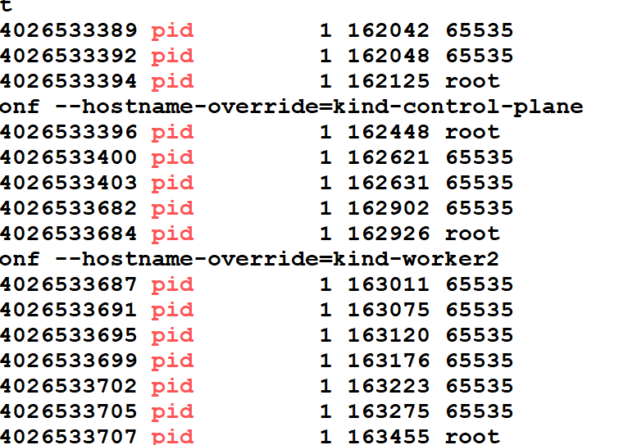
PID namespace
PID Namespace: Process isolation (PID: Process ID)
General Process Sharing: All processes on a system share the same PID namespace.
Docker’s Approach: Each container has its own PID namespace, allowing processes within the container to have their unique set of process IDs.

Slide 7
Net Namespace: Managing network interfaces (NET: Networking)
General Process Sharing: Processes often share the same network namespace, leading to potential conflicts.
Docker’s Approach: Each container gets its isolated network namespace, enabling independent network configurations and avoiding interference between containers
IPC Namespace: Managing access to IPC resources (IPC: InterProcess Communication)
General Process Sharing: Processes share the same IPC namespace, leading to shared resources and potential conflicts.
Docker’s Approach: Containers have separate IPC namespaces, providing isolation for inter-process communication.

Slide 8
MNT Namespace: Managing filesystem mount points (MNT: Mount)
General Process Sharing: Processes typically share the same mount namespace, making file system management challenging.
Docker’s Approach: Containers have their own mount namespace, ensuring that file systems are isolated and can be managed independently.
UTS Namespace: Different host and domain names (UTS: Unix Timesharing System)
General Process Sharing: Processes usually share the same UTS namespace, making hostname conflicts possible.
Docker’s Approach: Containers have their own UTS namespace, allowing each container to have a unique hostname

Slide 9
USER Namespace:
General Process Sharing: Processes can see the userIDs and groupIDs of other processes in same namespaces.
Docker’s Approch: Isolate the user IDs and group IDs of processes in a container. This means that processes in one container cannot see the user IDs and group IDs of processes in another contai

Slide 10
labs

Slide 11
cgroups
We could have created a process separate from the other process with Linux namespaces. But if we create multiple namespaces, then how can we limit the resources of each namespace so that it doesn’t take up the resources of another namespace?
Cgroups (abbreviated from control groups) is a Linux kernel feature that limits, accounts for, and isolates the resource usage (CPU, memory, disk I/O, network, etc.) of a collection of process

Slide 12
Cgroups in Docker
Cgroups are essential for controlling how processes in containers consume system resources. They allow Docker to:
Limit Resource Usage: Prevent any single container from consuming excessive resources.
Isolate Resources: Ensure that containers do not impact each other’s performance.
Monitor Resource Consumption: Track the usage of CPU, memory, and I/O resources.
By default, when you run a container using docker run, Docker does not impose any resource limits on CPU or memory. The container can use as much CPU and memory as the host system allows. However, you can set resource limits explicitly.

Slide 13
labs

